Slide 1

Go
Group 3
Jiahao Peng, Weihang Chen, Yuxiao Cai, Ye Wang

Slide 2




Catalogue
Criteria for programming language evaluation
Evaluation for Go
Brief description of project

Slide 3

Evaluation Criteria
Readability
Writability
Reliability
Cost
Package Ecosystem
Learning Materials
Employability

Slide 4

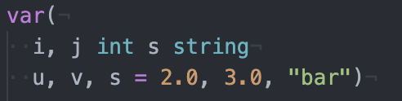
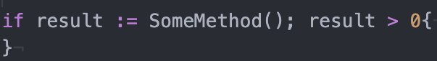
Readability
For Golang
Measured by:
● Overall simplicity
● Data types
● Syntax considerations
● string, slice, map, complex64, error, interface{},chan……

Slide 5
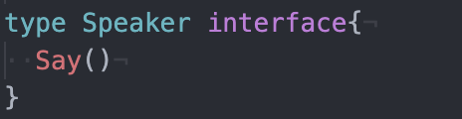
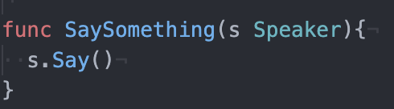
Writability
For Golang
Measured by:
● Simplicity
●
Support for abstraction & Expressivity

Slide 6
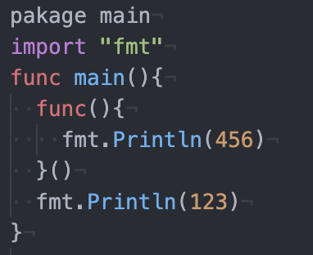
Reliability
For Golang
● Type errors will be found during compilation. The compiler of Golang uses static type checking to ensure the type safety of the program.
Measured by:
● Type checking
● Exception handling
● Aliasing

Slide 7
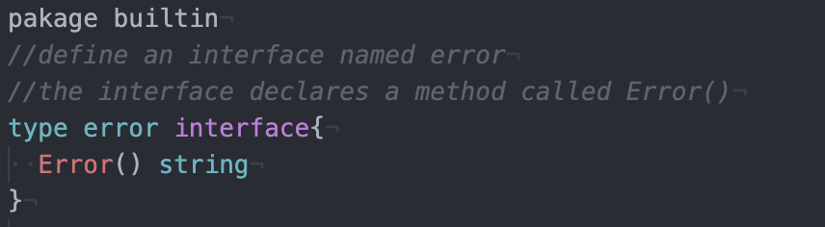
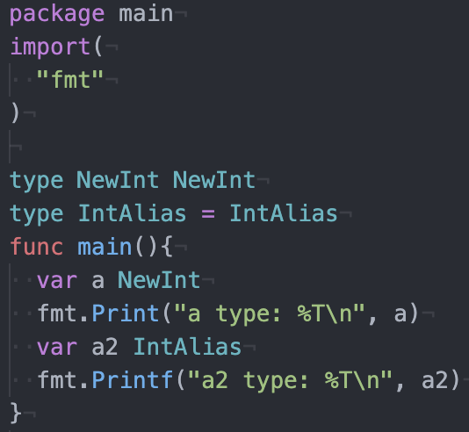
Reliability for Golang(continued)
Error interface
Golang also has panic, recover and defer.
Type aliasing

Slide 8
 | Java | JavaScript | C | C++ | Golang
Simplicity | NO | NO | NO | NO | YES
Abstraction | NO | NO | NO | NO | YES
Data Types | YES | YES | YES | YES | YES
Exception handling | YES | YES | YES | YES | YES
Aliasing | YES | YES | YES | YES | YES

Slide 9
Cost
For Golang
Golang is simpler, easier to learn and cheaper to train programmers than other languages.
Measured by:
● Training programmers
Golang is a compiled language that requires no environment deployment, no compatibility issues with multi-version shared environments, and easy operation and maintenance.
● Writing programs
● Executing

Slide 10
Package Ecosystem
Measured by:
● Maven is considered the de-facto Java package manager.
● C/C++ does not have a centralized package ecosystem
● Gopm is Golang package ecosystem
 | Java | JavaScript | C | C++ | Golang
Package Ecosystem | 43,7116 | 1,083,580 |  |  | <10,000

Slide 11
Learning Materials
Measured by:
● Number of Books returned by search term “Golang programming language” on Amazon
● Number of courses on Udemy
 | Java | JavaScript | C | C++ | Golang
Amazon Books | >5,000 | >2,000 | >5,000 | >10,000 | >10,000
Udemy Course | 1,080 | 688 | 306 | 8 | 132

Slide 12
Employability
Measured by:
● Number of impressions of “Golang developer” on popular job sites
 | Java | JavaScript | C | C++ | Golang
Indeed (DC) | 7,298 | 2,836 | 1,192 | 1,890 | 549
Indeed(CA) | 11,176 | 3,545 | 1,915 | 3,380 | 2,192
Linkedin(DC) | 52,511 | 47,699 | 16,296 | 41,994 | 23,199
Linkedin(CA) | 116,438 | 110,085 | 48,516 | 103,633 | 74,803

Slide 13
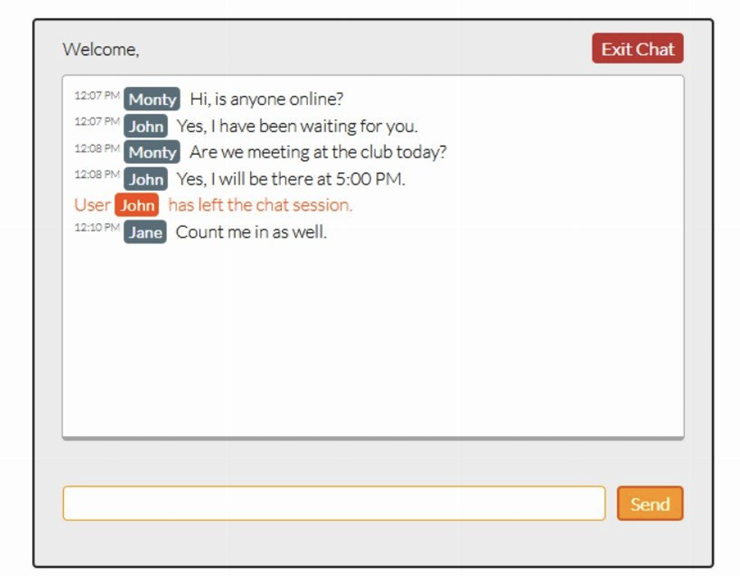
Brief description of project
a. Objective of your project
To achieve an online chat room

Slide 14
Brief description of project
b. Constraints
Time: 3 weeks(Requirement Analysis,Design,Implementation,Testing,Evolution)
Scope: An online chat room
Cost: free(Go is an open source programming language)

Slide 15
Brief description of project
c. Features
1. Display the ID of the user
2. Display the message of the user
3. Display the user's online status

Slide 16
Brief description of project
d. Technology that will be used
·GO Programming
·websocket

Slide 17
Brief description of project
e. where this project can be applied
Displayed by the browser on a web page

Slide 18
Thank you for your patience!
If you have any question, we will be very glad to answer it.

